Slide 1

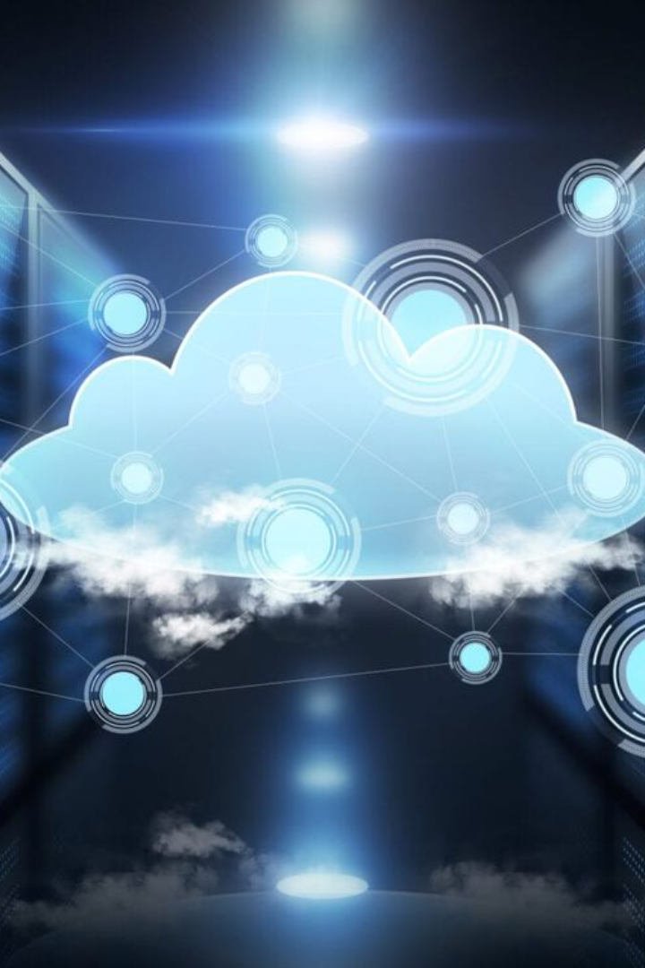


Cloud Computing
Cloud computing is the delivery of computing services—servers, storage, databases, networking, software, analytics, and intelligence—over the Internet ("the cloud") to offer faster innovation, flexible resources, and economies of scale. It provides businesses with the ability to scale as needed while only paying for what they use. This technology has revolutionized the way businesses operate, allowing for remote work, seamless collaboration, and secure data storage. The scalability, security, and cost-effectiveness of cloud computing make it an indispensable tool for companies of all sizes.
by Sangeetha D

Slide 2
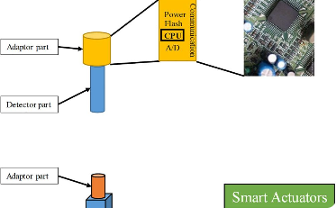
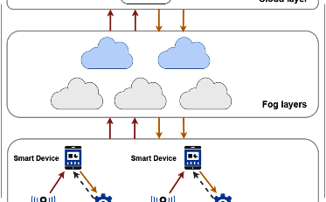
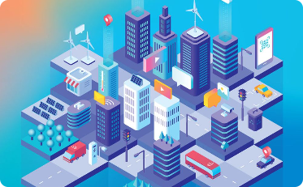
Sensor-Cloud
Smart Sensor Network
Data Accessibility
Integration with IoT
Sensor-cloud combines the power of cloud computing with sensor networks to collect, process, and analyze data from various physical environments. This integration allows for real-time monitoring, analysis, and decision-making, leading to improved efficiency and accuracy in a wide range of industries such as agriculture, manufacturing, and healthcare.
By leveraging cloud infrastructure, sensor-cloud provides accessibility to data from anywhere at any time. This seamless accessibility allows for rapid response to changes and swift decision-making based on real-time data, ultimately leading to enhanced operational control and efficiency.
The integration of sensor-cloud with the Internet of Things (IoT) enables the creation of smart environments, where sensor data is leveraged for automating processes, optimizing resource usage, and enhancing overall quality of life in urban and rural settings.

Slide 3

Smart Cities and Smart Homes
Urban Infrastructure
Home Automation
Smart cities leverage IoT, sensor networks, and data analytics to optimize energy usage, improve traffic and transportation systems, enhance public safety, and provide efficient waste management, contributing to a sustainable and high-quality urban environment.
Smart homes use connected devices and sensors for automating and controlling household systems such as lighting, climate, entertainment, and security. This technology provides convenience, energy efficiency, and enhanced security for homeowners.
Connectivity
Both smart cities and smart homes rely on robust connectivity and communication infrastructure to enable seamless data exchange and real-time monitoring, leading to improved decision-making, resource optimization, and enhanced quality of life.

Slide 4
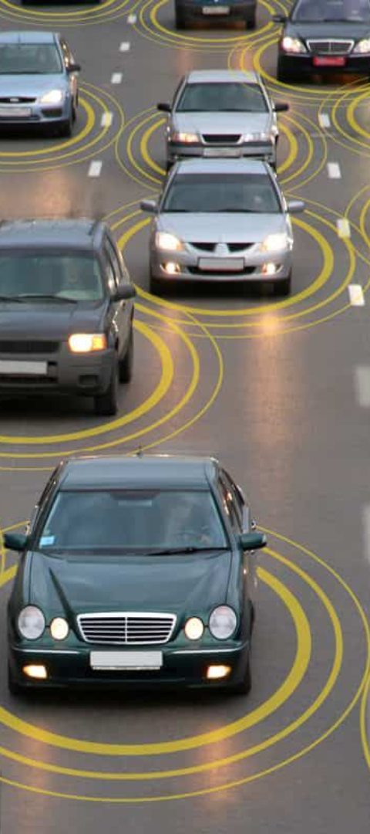
Connected Vehicles
1
Vehicle-to-Vehicle Communication
Connected vehicle technology allows cars to communicate with each other to share information about road conditions, traffic, and potential hazards, contributing to safer and more efficient transportation systems.
2
Autonomous Driving
Integration of connected vehicle systems with AI and sensor technologies enables autonomous driving features, reducing the risk of accidents, optimizing fuel consumption, and providing a more comfortable and productive travel experience.
3
Telematics and Fleet Management
Connected vehicles utilize telematics for tracking and managing fleets, optimizing routes, monitoring vehicle performance, and improving overall safety and efficiency in transportation and logistics operations.

Slide 5
Smart Grid
1
Grid Modernization
2
Renewable Energy Integration
The smart grid integrates advanced communication and control technologies into the traditional power grid, enabling real-time monitoring, efficient energy distribution, and rapid response to outages and disturbances.
Smart grid systems facilitate the integration of renewable energy sources such as solar and wind power, providing a reliable and sustainable energy infrastructure that reduces environmental impact and enhances energy resilience.
3
Energy Management
4
Cybersecurity
Smart grid technologies enable consumers to actively manage their energy usage, offering tools for energy conservation, demand-response programs, and the ability to make informed decisions about energy consumption.
Security measures are a crucial component of the smart grid, ensuring protection against cyber threats, unauthorized access, and data breaches, safeguarding the integrity and reliability of the energy infrastructure.

Slide 6
Industrial IoT
Enhanced Monitoring
Predictive Analytics
Automation and Robotics
Industrial IoT enables real-time monitoring of machinery, equipment, and production processes, providing valuable insights into performance, maintenance needs, and operational efficiencies, leading to proactive maintenance and reduced downtime.
By harnessing data from sensors and connected devices, industrial IoT facilitates predictive analytics for anticipating equipment failures, optimizing supply chain operations, and guiding strategic decision-making for improved productivity and cost savings.
Integration of IoT with automation and robotics revolutionizes manufacturing processes, enhancing precision, speed, and customization capabilities, while streamlining production and reducing labor-intensive tasks.

Slide 7
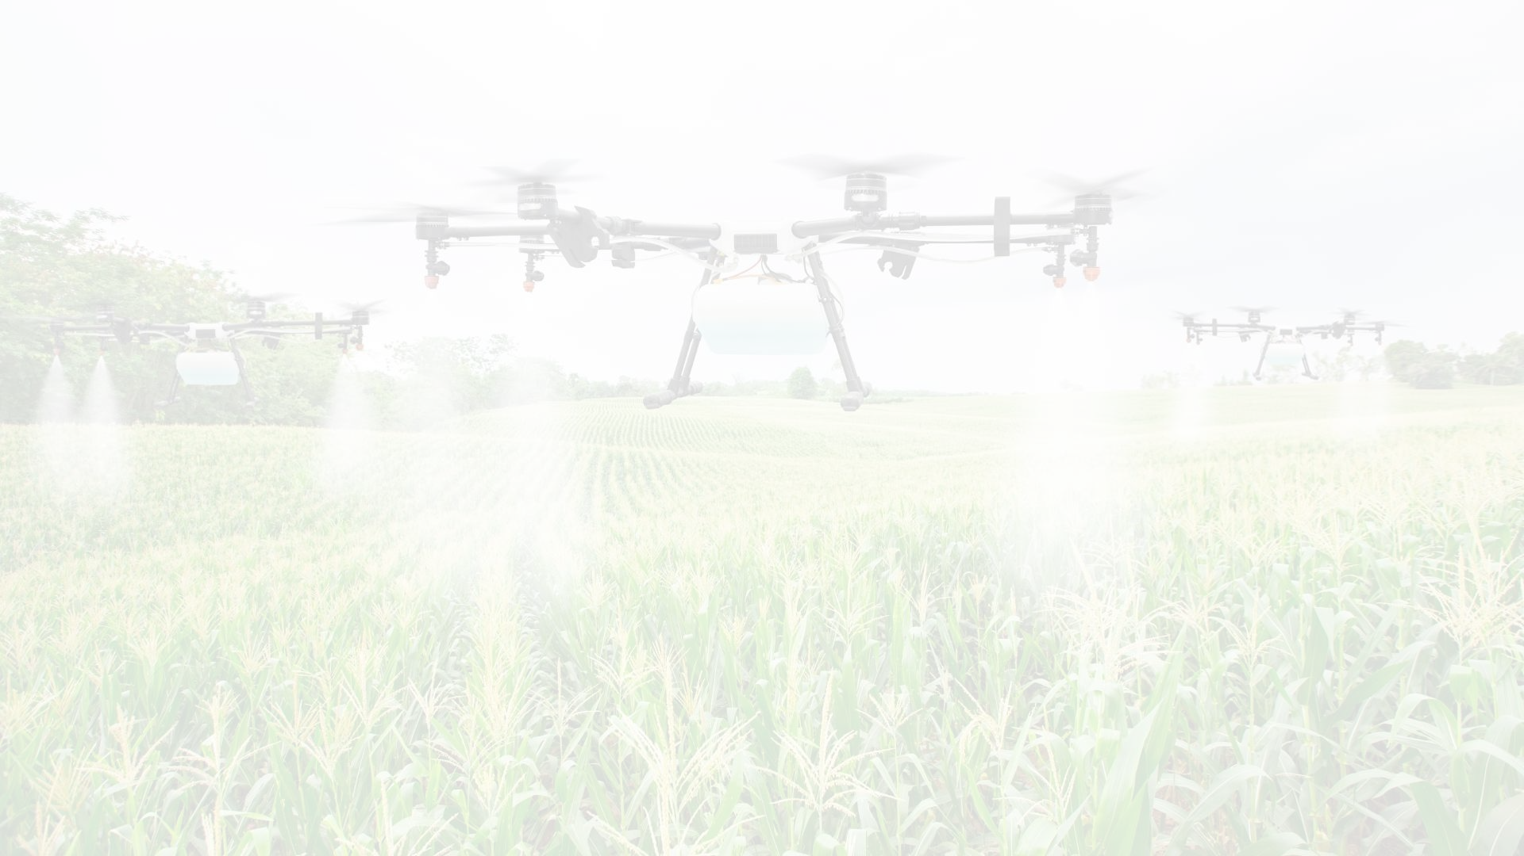



Case Study: Agriculture
Data-Driven Farming
Remote Monitoring
Supply Chain Integration
Data analytics and IoT sensors enable precision agriculture, optimizing irrigation, fertilization, and pesticide use based on real-time environmental and crop data, leading to enhanced yields and sustainability.
Remote sensing technology and cloud-based solutions allow farmers to monitor crop health, soil conditions, and weather patterns, empowering informed decision-making and early detection of potential issues.
Integration of IoT in agriculture extends to supply chain management, ensuring traceability, quality control, and efficient distribution of produce, contributing to improved food safety and reduced food wastage.

Slide 8
Case Study: Health
Remote Patient Monitoring
Healthcare providers use IoT devices to remotely monitor and manage patient health, allowing for early intervention, reducing hospital readmissions, and enhancing patient outcomes.
Telemedicine
Telemedicine platforms and connected medical devices enable virtual consultations, diagnosis, and treatment, providing access to healthcare services regardless of geographical barriers.
Health Management Platforms
Integrated IoT platforms offer health tracking and management tools for individuals, allowing personalized wellness routines, chronic disease management, and proactive health monitoring.

